Slide 1
PPInsight Technology Review
Ike K., Maya G.H., Rita K., Fiona M, and Walter A.

Slide 2
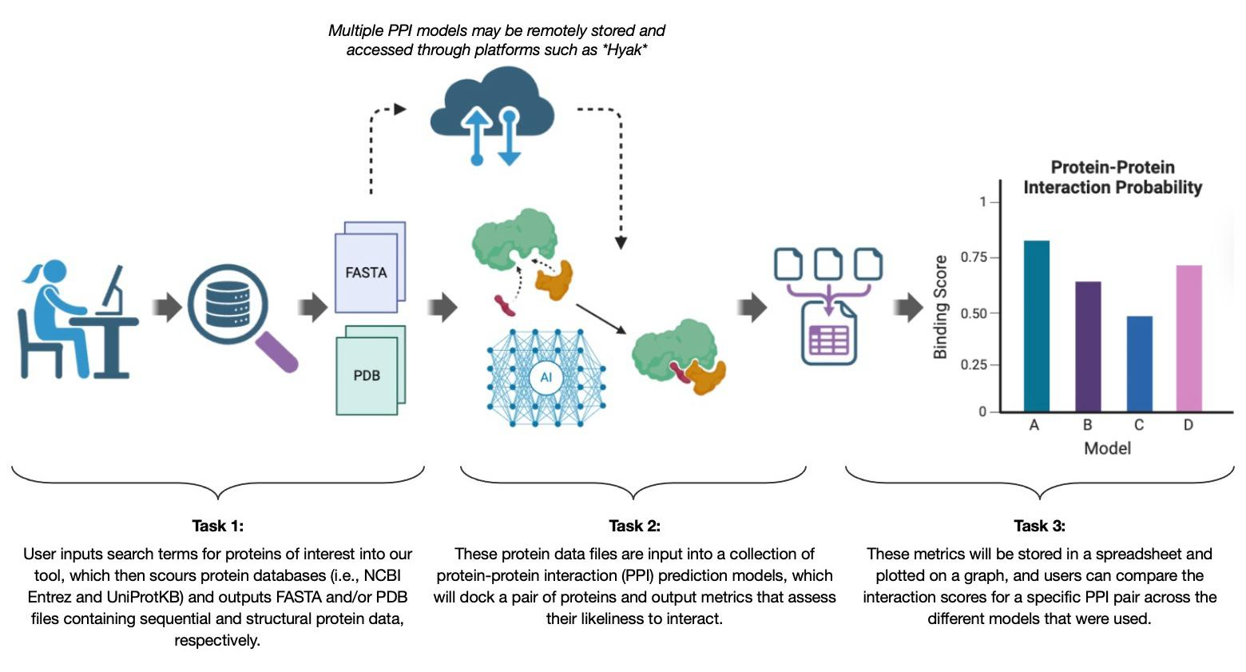
Conceptual Framework

Slide 3
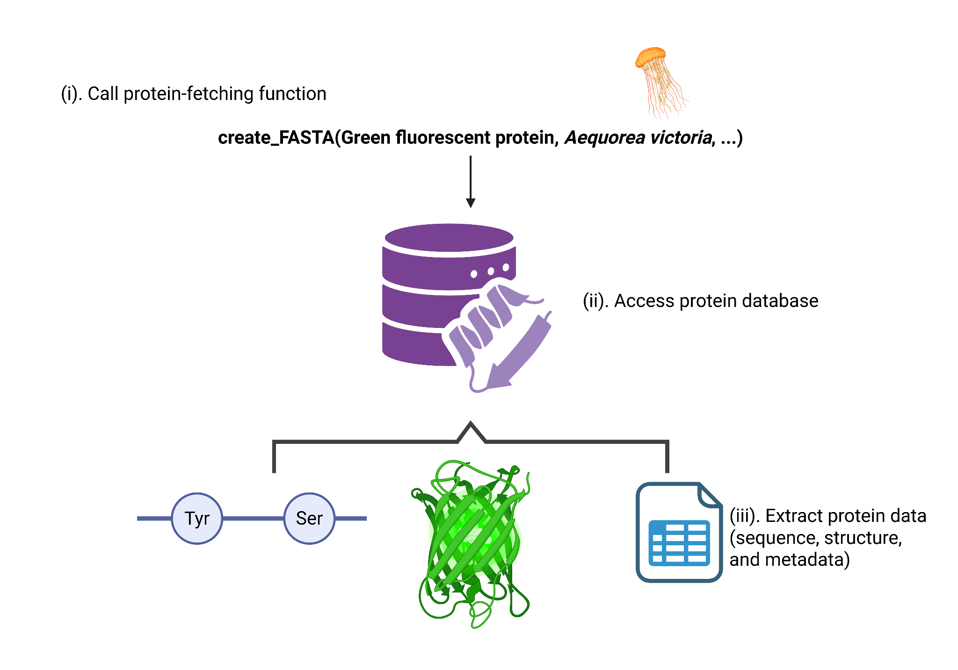
Task 1 - Fetching protein data

Slide 4


Option 1: Biopython UniProt API
Function
  Accesses the UniProt database
  Can be integrated with BioPython
Appeal of package
  All proteins reviewed Swiss-Prot entries – high quality
  Can use any programming language
Downsides
  Does not include DNA structures or other molecules
  Currently undergoing transition that will remove many files
Helpful links
  https://github.com/ebi-uniprot
  https://biopython.org/docs/dev/api/Bio.UniProt.html
  https://www.uniprot.org/help/programmatic_access
Notes:
UniProt API accesses the UniProt database, which can also be done via BioPython. This is a good option because all the proteins in this database are reviewed by the Swiss Institute of Bioinformatics, which ensures that all data are high-quality. The API also lets you use any programming language to interface with the database website, so it’s a good option for users who come from diverse programming backgrounds. (Although this could also be an issue since we plan to have a Python-based workflow for this project.) The biggest drawback of UniProt is that it only contains proteins. Unlike Entrez, there are no DNA structures or other molecules, so interactions that involve a non-protein catalyst cannot be modeled. Additionally, the database is currently making major changes which involve removing files of taxonomically unclassified proteins, potentially causing nasty surprises for users until this process is finished some time in 2026.

Slide 5

Option 2: Biopython Entrez
Function
  Provides a Python interface to NCBI’s Entrez databases
Appeal of package
  Well documented library and widely used in bioinformatics
  Entrez contains sequence data for different molecule types
Downsides
  Contains sequence only data (no structures)
  Ambiguous search results (e.g., multiple hits for one protein name)
Helpful links
  https://github.com/jordibc/entrez
  https://biopython.org/docs/1.76/api/Bio.Entrez.html
Notes:
Another technology option to help us carry out our first task is Biopython Entrez. This is a package in the Biopython library that provides a direct interface to NCBI’s Entrez databases, which includes sequence data for biological molecules.
One strength of the Entrez database is that it contains sequences for DNA and RNA. So if someone is using our tool to run PPI models on protein-interactions that require a non-protein binding partner, they could easily fetch sequence data for that molecule via Entrez.
However one downside to Entrez is that it only provides sequence data, not 3D structural files, so those would need to be pulled from a separate database using different Biopython packages if a certain PPI model downstream required structural inputs to make predictions.
Another issue is that searches can sometimes return multiple hits for the same protein name, which means we’d have to add extra code to handle or disambiguate those results.

Slide 6

Option 3: Entrez CLI
Same database and capabilities
Good for Parallel computation

Slide 7



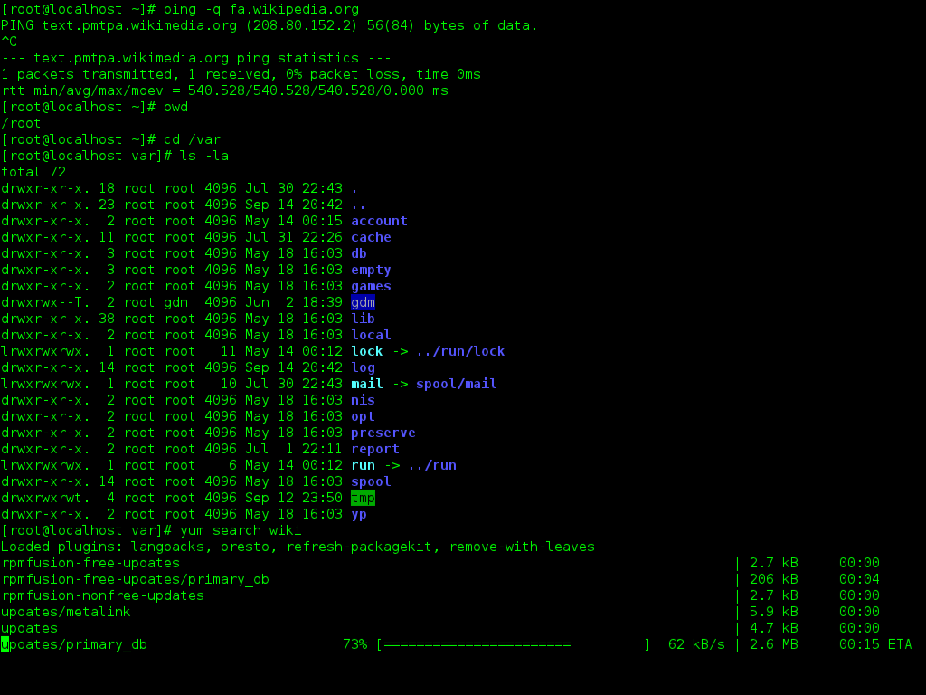
Summary of Selections
Source Options
Option 1: Biopython UniProt API
Option 2: Biopython Entrez
Access Alternative
Option 3: Entrez CLI
Notes:
Summary of selections
So the first two packages utilize biopython: which is an open-source collection of Python tools and libraries for computational biology and bioinformatics
include FASTA, FASTQ, GenBank, and EMBL
But the key differences that we see are : Uniprot- a higher class protein database, it highly specializes in protein-protein interactions, but because of that higher standard we may have files removed in the future which may necessitate having to change gears in the future
Enterez - less organized, but more widely used in the bioinformatics field but has some limitations such as containing only sequence data
Enterez is the choice source for downloading protein information- then the final step is choosing if we want it to be integrated through a python based packaging system or directly from the command line interface.
A CLI allows us to be able to ensure longevity as well as have the availability of parllelization. This could be better if biopython packages updates, but can be more arduous on the front end as well as more complex- which may not be necessary for the scope of this project, but may be more useful if we were to have a more integrated and established software.

